Slide 1
5.8 爬取京东商城网站数据

Slide 2
任务目标
1.
1. 京东商城有大量的商品数据，在搜索框中输入某类商品，例如"手机"，点击“搜索”按钮就可以看到近百页手机的信息。
2. 现在我们使用Selenium编写一个爬虫程序，自动在输入框输入"手机"，点击“搜索”按钮，自动翻页爬取所有手机的数据与图像，并保存到数据库。

Slide 3
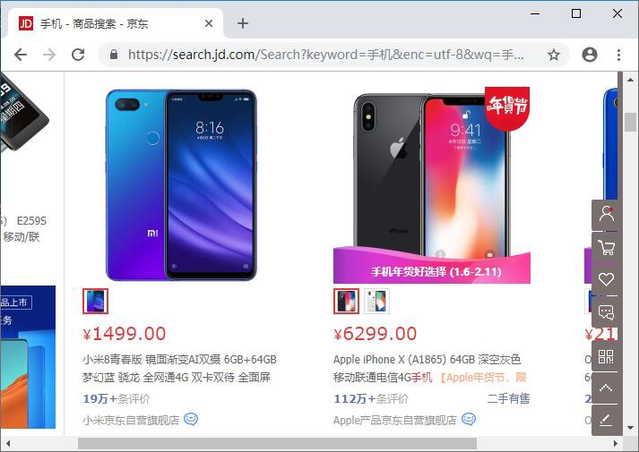
京东网站
2.

Slide 4
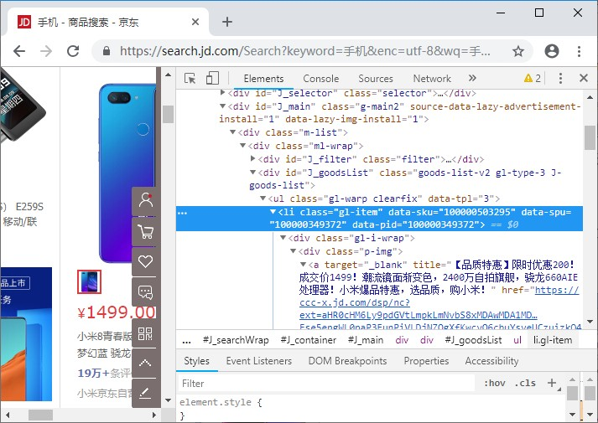
京东网站
2.
手机信息所在位置

Slide 5
爬取手机<li>元素
3.
从HTML中可以看到 每个<li>都包含在<div id="J_goodsList">下面的，而且每个<li>都是<li class="gl- item">的格式，因此使用：
lis =self.driver.find_elements_by_xpath("//div[@id='J_goodsList']//li[@class='gl-item']")
for li in lis:
# 从li爬取数据 在循环可以得到每个<li>元素，每部手机的数据从li对象中进一步爬取。

Slide 6
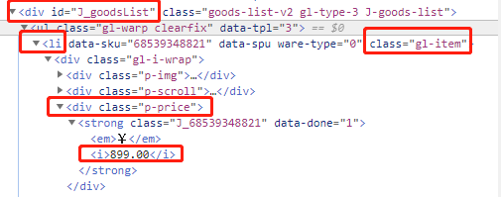
爬取价格
3.
价格存在于<div class='p-price'>下面的一个<i>元素下，因此 price价格这样爬取：
try:
price = li.find_element_by_xpath(".//div[@class='p-price']//i").text
except:
price = "0"

Slide 7
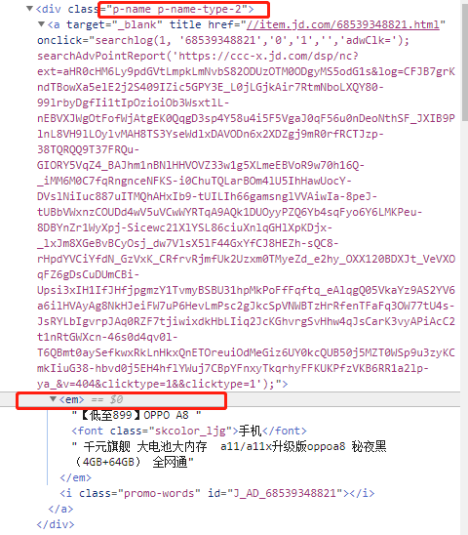
爬取品牌与简介
3.
品牌与简介存在于<div class='p-name p-name-type-2'>下面的<em>元 素中，而且品牌时这个<em>下面文字中的第一个部分（用空格分 开），因此品牌mark与简介note如下：
try:
note = li.find_element_by_xpath(".//div[@class='p-name p-name-type-
2']//em").text
mark = note.split(" ")[0]
mark = mark.replace("爱心东东\n", "") mark = mark.replace(",", "")
note = note.replace("爱心东东\n", "") note = note.replace(",", "")
except:
note = "" mark = ""

Slide 8
爬取图像地址
3.
仔细分析HTML代码可以看到手机图像存在于<div class="p-img">下面的一个<a>超级链接的<img>元素中，图像要么存储于<img>的src属性， 要存储在<img>的data-lazy-img属性，因此我们在这个两个属性中去取两个地址src1与src2，程序如下：
try:
src1 = li.find_element_by_xpath(".//div[@class='p-img']//a//img").get_attribute("src")
except:
src1=""
try:
src2 = li.find_element_by_xpath(".//div[@class='p- img']//a//img").get_attribute("data-lazy-img")
except:
src2=""

Slide 9
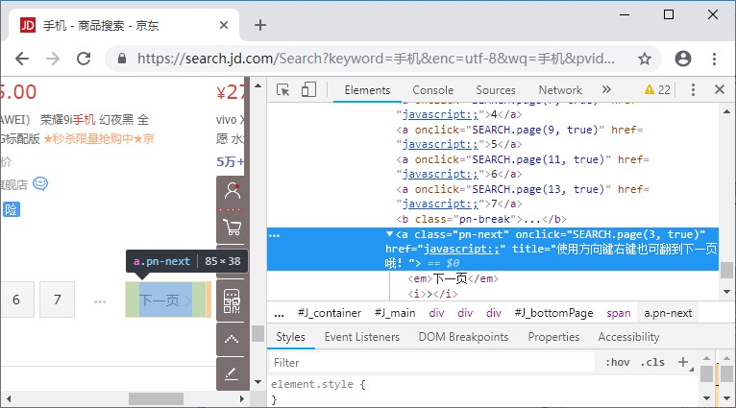
实现网页翻页
4.

Slide 10
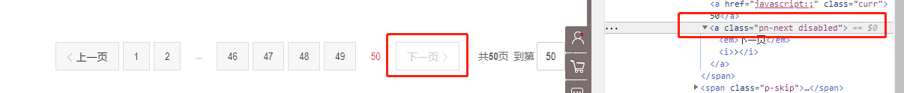
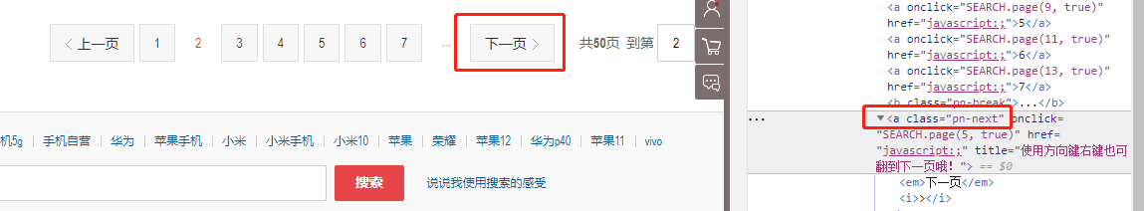
页面跳转

Slide 11
实现网页翻页
3.
只要找到<span class="p-num">，然后找到"下一页"的超级链接，在正常能翻页时超级链接是<a class='pn-next'>，到最后一页不能翻页时变成<a class='pn-next-disabled'>，因此编写下列程序找到nextPage就能实现翻页：
try:
self.driver.find_element_by_xpath("//span[@class='p-
num']//a[@class='pn-next disabled']")
except:
nextPage = self.driver.find_element_by_xpath("//span[@class='p-
num']//a[@class='pn-next']")
nextPage.click()
如果没有找到<a class='pn-next-disabled'>元素就找<a class='pn-next'>
元素，然后使用nextPage.click()实现翻页。

Slide 12
爬虫程序的源码 1
from selenium import webdriver
from selenium.webdriver.chrome.options import Options
import urllib.request
import threading
import sqlite3
import os
import datetime
from selenium.webdriver.common.keys import Keys
import time
class MySpider:
headers = {
"User-Agent": "Mozilla/5.0 (Windows; U; Windows NT 6.0 x64; en-US; rv:1.9pre) Gecko/2008072421 Minefield/3.0.2pre"}
imagePath = "download"

Slide 13
爬虫程序的源码 2
def startUp(self, url, key):
# # Initializing Chrome browser
# chrome_options = Options()
# chrome_options.add_argument('--headless')
# chrome_options.add_argument('--disable-gpu')
# self.driver = webdriver.Chrome(chrome_options=chrome_options)
# Initializing variables
self.threads = []
self.No = 0
self.imgNo=0
# Initializing database
try:
self.con = sqlite3.connect("phones.db")
self.cursor = self.con.cursor()
try:
# 如果有表就删除
self.cursor.execute("drop table phones")
except:
pass

Slide 14
爬虫程序的源码 3
try:
# 建立新的表
sql = "create table phones (mNo varchar(32) primary key, mMark varchar(256),mPrice varchar(32),mNote varchar(1024),mFile varchar(256))"
self.cursor.execute(sql)
except:
pass
except Exception as err:
print(err)
# Initializing images folder
try:
if not os.path.exists(MySpider.imagePath):
os.mkdir(MySpider.imagePath)
images = os.listdir(MySpider.imagePath)
for img in images:
s = os.path.join(MySpider.imagePath, img)
os.remove(s)
except Exception as err:
print(err)

Slide 15
爬虫程序的源码 4
self.driver.get(url)
keyInput = self.driver.find_element_by_id("key")
keyInput.send_keys(key)
keyInput.send_keys(Keys.ENTER)
def closeUp(self):
try:
self.con.commit()
self.con.close()
self.driver.close()
except Exception as err:
print(err);
def insertDB(self, mNo, mMark, mPrice, mNote, mFile):
try:
sql = "insert into phones (mNo,mMark,mPrice,mNote,mFile) values (?,?,?,?,?)"
self.cursor.execute(sql, (mNo, mMark, mPrice, mNote, mFile))
except Exception as err:
print(err)

Slide 16
爬虫程序的源码 5
def showDB(self):
try:
con = sqlite3.connect("phones.db")
cursor =con.cursor()
print("%-8s%-16s%-8s%-16s%s"%("No", "Mark", "Price", "Image", "Note"))
cursor.execute("select mNo,mMark,mPrice,mFile,mNote from phones order by mNo")
rows = cursor.fetchall()
for row in rows:
print("%-8s %-16s %-8s %-16s %s" % (row[0], row[1], row[2], row[3],row[4]))
con.close()
except Exception as err:
print(err)

Slide 17
爬虫程序的源码 6
def download(self, src1, src2, mFile):
data = None
if src1:
try:
req = urllib.request.Request(src1, headers=MySpider.headers)
resp = urllib.request.urlopen(req, timeout=10)
data = resp.read()
except:
pass
if not data and src2:
try:
req = urllib.request.Request(src2, headers=MySpider.headers)
resp = urllib.request.urlopen(req, timeout=10)
data = resp.read()
except:
pass
if data:
print("download begin", mFile)
fobj = open(MySpider.imagePath + "\\" + mFile, "wb")
fobj.write(data)
fobj.close()
print("download finish", mFile)

Slide 18
爬虫程序的源码 7
def processSpider(self):
try:
time.sleep(1)
print(self.driver.current_url)
lis =self.driver.find_elements_by_xpath("//div[@id='J_goodsList']//li[@class='gl-item']")
for li in lis:
# We find that the image is either in src or in data-lazy-img attribute
try:
src1 = li.find_element_by_xpath(".//div[@class='p-img']//a//img").get_attribute("src")
except:
src1 = ""
try:
src2 = li.find_element_by_xpath(".//div[@class='p-img']//a//img").get_attribute("data-lazy-img")
except:
src2 = ""

Slide 19
爬虫程序的源码 8
try:
price = li.find_element_by_xpath(".//div[@class='p-price']//i").text
except:
price = "0"
try:
note = li.find_element_by_xpath(".//div[@class='p-name p-name-type-2']//em").text
mark = note.split(" ")[0]
mark = mark.replace("爱心东东\n", "")
mark = mark.replace(",", "")
note = note.replace("爱心东东\n", "")
note = note.replace(",", "")
except:
note = ""
mark = ""

Slide 20
爬虫程序的源码 9
self.No = self.No + 1
no = str(self.No)
while len(no) < 6:
no = "0" + no
print(no, mark, price)
if src1:
src1 = urllib.request.urljoin(self.driver.current_url, src1)
p = src1.rfind(".")
mFile = no + src1[p:]
elif src2:
src2 = urllib.request.urljoin(self.driver.current_url, src2)
p = src2.rfind(".")
mFile = no + src2[p:]
if src1 or src2:
T = threading.Thread(target=self.download, args=(src1, src2, mFile))
T.setDaemon(False)
T.start()
self.threads.append(T)
else:
mFile = ""
self.insertDB(no, mark, price, note, mFile)

Slide 21
爬虫程序的源码 10
# 取下一页的数据，直到最后一页
try:
self.driver.find_element_by_xpath("//span[@class='p-num']//a[@class='pn-next disabled']")
except:
nextPage = self.driver.find_element_by_xpath("//span[@class='p-num']//a[@class='pn-next']")
time.sleep(10)
nextPage.click()
self.processSpider()
except Exception as err:
print(err)
def executeSpider(self, url, key):
starttime = datetime.datetime.now()
print("Spider starting......")
self.startUp(url, key)
print("Spider processing......")
self.processSpider()
print("Spider closing......")
self.closeUp()
for t in self.threads:
t.join()
print("Spider completed......")
endtime = datetime.datetime.now()
elapsed = (endtime - starttime).seconds
print("Total ", elapsed, " seconds elapsed")

Slide 22
爬虫程序的源码 11
url = "http://www.jd.com"
spider = MySpider()
while True:
print("1.爬取")
print("2.显示")
print("3.退出")
s = input("请选择(1,2,3):")
if s == "1":
spider.executeSpider(url, "手机")
continue
elif s == "2":
spider.showDB()
continue
elif s == "3":
break

Slide 23
THANK YOU

